Slide 1
Spooky SQL Carnival
PASS Speaker Idol 2019
William Assaf

Slide 2
Agenda of Terror
HORRIFYING nonsequential newsequentialid() GUIDs
SHOCKING foreign key behavior
TERRIFYING duplicate primary keys

Slide 3
Carnival of SQL Spookyness
Scary, frightening database sights!
Proceed only if you dare! We are not responsible for any injuries resulting from previously existing medical conditions.
Features of night, brought to light!

Slide 4
Fright #1
Proceed only if you dare, and have never thought that using newsequentialid() is a good idea!
Behold, the terror of the newsequentialid()!

Slide 5
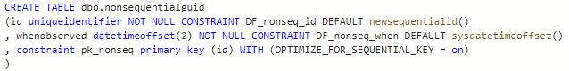
Nonsequential newsequentialid()
To set the stage we create a table with a uniqueidentifier column as the primary key and clustered index, using the newsequentialid() function as a default.

Slide 6
Nonsequential newsequentialid()
Ran some inserts, caused some things to happen, and then…

Slide 7
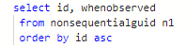

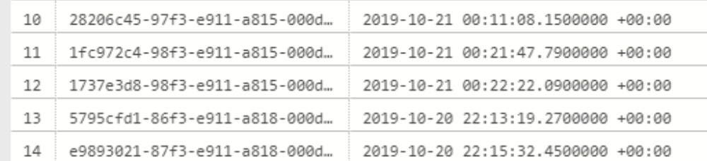
Nonsequential newsequentialid()
Released free for commercial use. https://pixabay.com/illustrations/cartoon-skeleton-character-906074/

Slide 8
INSERT SORT ORDER
Expected behavior
of newsequentialid()
Actual behavior
when seed changes
Server change!
Server change!
Server change!
Server change!
Server change!
Server change!
Server change!
No Fragmentation
Fragmentation Upon Insertion

Slide 9
HowTo: Nonsequential sequential GUID
Failover to another machine in FC or AG
Upgrade or Migrate to new hardware
Upgrade or Migrate to new platform
Change the tier of Azure SQL DB
Reimage an Azure VM with ephemeral OS
Any change to SQL Server’s NIC’s MAC

Slide 10
HowTo: Nonsequential sequential GUID
The C++ function UuidCreateSequential is based on the MAC address of the NIC.
"Therefore you should never use this UUID to identify an object that is not strictly local to your computer.“
Which may rule out any High Availability or portability! Scary!

Slide 11
Fright #2
Proceed only if you dare, and have never thought that foreign keys were magical! Behold, the shocking truths of foreign keys!

Slide 12
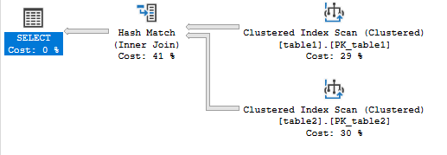
Foreign Key Frights
I put 32000 rows in two tables.
SELECT table2.id
FROM table1 inner join table2
ON table1.id = table2.table1id;

Slide 13
Foreign Keys Check
Now I’m going to add a Foreign Key on Table2.table1id, referencing table1.id.

Slide 14
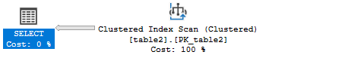
Foreign Key Frights
Now, keep your eye on the Scan on table1.
SELECT table2.id
FROM table1 inner join table2
ON table1.id = table2.table1id;
Released free for commercial use. https://pixabay.com/illustrations/cartoon-skeleton-character-906074/

Slide 15
Foreign Keys Check
The Foreign Key allowed the query to disappear the scan,
dropping the cost from 1.25 to 0.37
without changing code or indexes!

Slide 16
Foreign Keys Check
Now, watch as I relive my horror from SQLSaturday Pensacola 2012,
when I was there competing at a lunch-time lightning talk
And could not frighten the audience with the magic disappearing scan trick

Slide 17
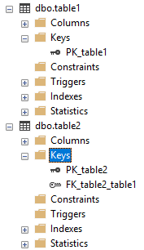
Foreign Keys Check
The foreign key was there!
The data was there!
But the second index scan just wouldn’t die.

Slide 18
Foreign Keys Check
The foreign key was there!
Valid data was in the tables!
Invalid inserts were disallowed!
But the second index scan in my sample query just wouldn’t die.

Slide 19
Foreign Keys Check
The foreign key was there!
Valid data was in the tables!
Invalid inserts were disallowed!
But the second index scan in my sample query just wouldn’t die.

Slide 20
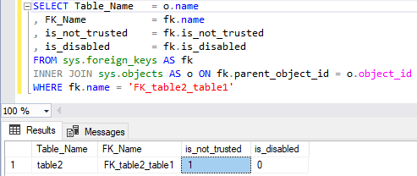
Foreign Keys Check
Later, I found the spook in my database. The FK was enabled, but not trusted!

Slide 21
Ever seen SSMS script out a FK like this?
ALTER TABLE [table2] WITH NOCHECK ADD CONSTRAINT [FK_table2_table1] FOREIGN KEY([table1id])
REFERENCES [table1] ([id]);
GO
ALTER TABLE [table2] CHECK CONSTRAINT [FK_table2_table1];
The FK exists, blocks bad new inserts, but isn’t trusted, because it doesn’t evaluate existing rows, and so it won’t help performance. But worse…
Second script DOES NOTHING to an untrusted FK!

Slide 22
Ever seen SSMS script out a FK like this?
Instead of:
ALTER TABLE [table2]
CHECK CONSTRAINT [FK_table2_table1];
ALTER TABLE [table2]
WITH CHECK
CHECK CONSTRAINT [FK_table2_table1];
WITH CHECK CHECK. Seriously freaky!

Slide 23
Ever seen SSMS script out a FK like this?
Instead of:
ALTER TABLE [table2]
CHECK CONSTRAINT [FK_table2_table1];
ALTER TABLE [table2]
WITH CHECK
CHECK CONSTRAINT [FK_table2_table1];
WITH CHECK CHECK. Seriously freaky!

Slide 24
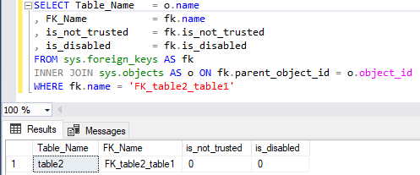
Foreign Keys Check
Now the FK is NOT not_trusted, and silently helping queries again!

Slide 25
Fright #3
Proceed only if you dare, and have ever thought the float data type was trustworthy! Behold, duplicate primary key horror!

Slide 26
Float as PK
Many businesses have an invoice or lineitem system that looks like this:
YearNumberNumber.lineitem
Which ends up looking like a number like this, for example:
2019000000000.001
2019000000000.002
2019000000000.003…

Slide 27
Float as PK
Many businesses have an invoice or lineitem system that looks like this:
YearNumInvoiceNum.LineItemNum
Which ends up looking like a number like this, for example:
2019000000000.001
2019000000000.002
2019000000000.003…

Slide 28
Float as PK
lab- float as pk problems.sql

Slide 29
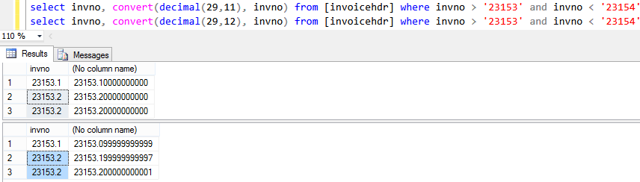
Float as PK
Converting float to decimal can be problematic!
Released free for commercial use. https://pixabay.com/illustrations/cartoon-skeleton-character-906074/

Slide 30
Float as PK
Float is a floating point number.
Approximate numeric data types do not store the exact values specified for many numbers; they store an extremely close approximation of the value, rounding up in Microsoft SQL Server.

Slide 31
Float as PK
You should only use float if the max precision of decimal (38 digits!) is insufficient.
Further warnings from Microsoft Docs:
“Avoid using float or real columns in WHERE clause search conditions, especially the = and <> operators.”

Slide 32
Thanks for your time!
Hopefully you are all not too scared to enjoy the rest of PASS Summit 2019!

